Slide 1
Lesson 1: Programming in SAS® Studio
1.1 Submitting SAS Code in SAS Studio
1.2 Using Features of the SAS Studio Editor
1.3 Converting Programs to SAS Studio

Slide 2
Lesson 1: Programming in SAS® Studio
1.1 Submitting SAS Code in SAS Studio
1.2 Using Features of the SAS Studio Editor
1.3 Converting Programs to SAS Studio

Slide 3


What Is SAS Studio?
You can write your own code or use the interface to generate code.
Notes:
SAS Studio is a browser-based programming interface that connects to a local or hosted SAS server. You can write your own SAS code or use the interface to generate SAS code automatically.

Slide 4
Data Used in This Course
fish
cars
sashelp
shoes
springs
Notes:
In this course, we want you to be as hands on as much as possible – because that's the best way to learn! We will use the cars, fish, shoes, and springs SAS tables in the sashelp library throughout this course. These data sets are available for you to replicate course activities and continue to work with after our course.

Slide 5
Practicing in This Course
Demonstration | Performed by your instructor as an example for you to observe
Activity | Short practice opportunities for you to perform in SAS, either independently or with the guidance of your instructor
Practice | Extended practice opportunities for you to work on independently
Notes:
As you go through the course, you have different opportunities to practice. You can watch the demos or you can follow along.

Slide 6

1.01 Activity
Start SAS Studio. On the Program 1 tab, enter the following SAS program and click (Run).
What similarities and differences do you observe compared to your previous method of submitting SAS code?
data fish2;
set sashelp.fish;
Ratio=height/weight;
run;
proc print data=fish2;
run;

Slide 7
Programming in SAS Studio
Editor
Tasks
Snippets
Notes:
SAS Studio offers a fully integrated programming interface, and includes the following resources:
an editor for writing and submitting your own programs
tasks that generate SAS code with user-supplied information, and
snippets of prewritten code

Slide 8
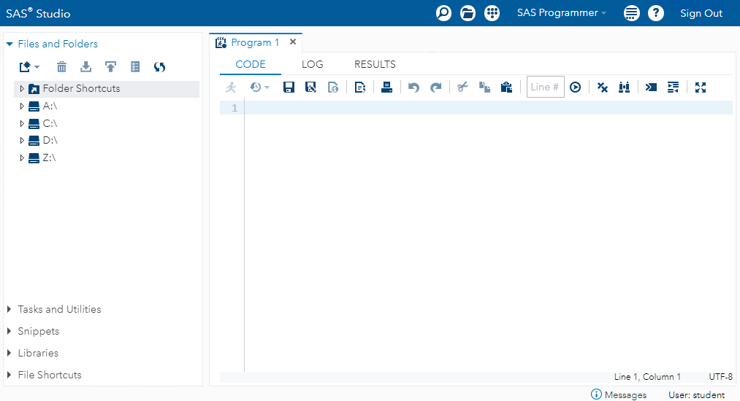
The SAS Studio Interface
Banner
Navigation Pane
Work Area
Notes:
The main window of SAS Studio consists of a navigation pane on the left, a work area on the right, and a banner area on the top. The work area is used to display your data, code, logs, and results with a tabbed interface. When you open data and run tasks, additional windows appear in the work area. Options are available in the banner area to customize your SAS Studio environment.

Slide 9
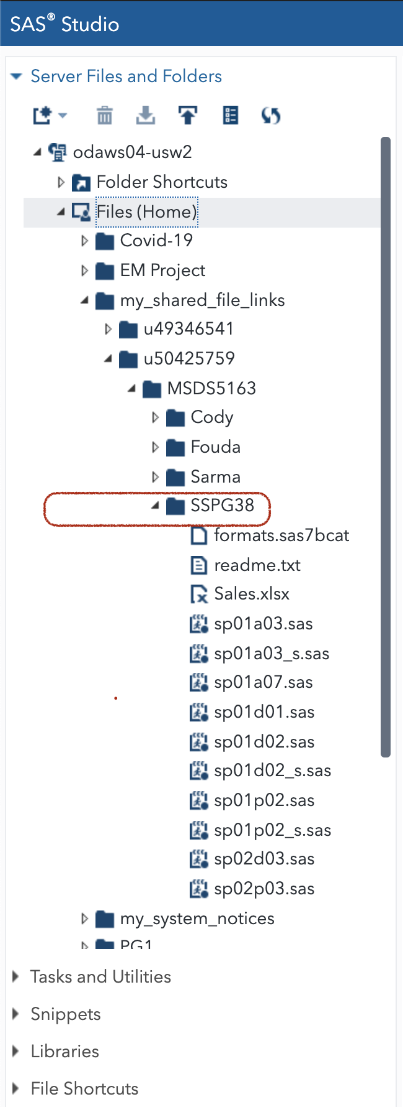
Accessing the Course Files
course files
For Example:
/home/u12345678/my_shared_file_links/u50425759/MSDS5163/SSPG38
This is your ”Files (Home)” aka ~
Notes:
For this course, you use a variety of data files and SAS programs. The SAS program files, the activities, demos, and practices, are organized into a course files folder. Make a note of the location of this folder.

Slide 10
Accessing the Course Files
Programs in the activities, demos, and practices follow this naming convention.
activities
course files
demos
practices
sp01d01.sas
SAS Studio Programming, Lesson 1, demo 1
Notes:
The course files folder contains SAS programs for you to use. The file names follow this naming convention: the name starts with SP for SAS Studio Programming, followed by two digits for the lesson number. Then the letter A, D, or P indicates activity, demo, or practice, followed by a sequential two-digit number within the lesson. When you come to an activity, demo, or practice, the instructions indicate the file that you need to open.

Slide 11
Opening, Modifying, and Submitting a SAS Program
This demonstration illustrates opening an existing SAS program, examining the log, making modifications, submitting a program, and viewing results.

Slide 12
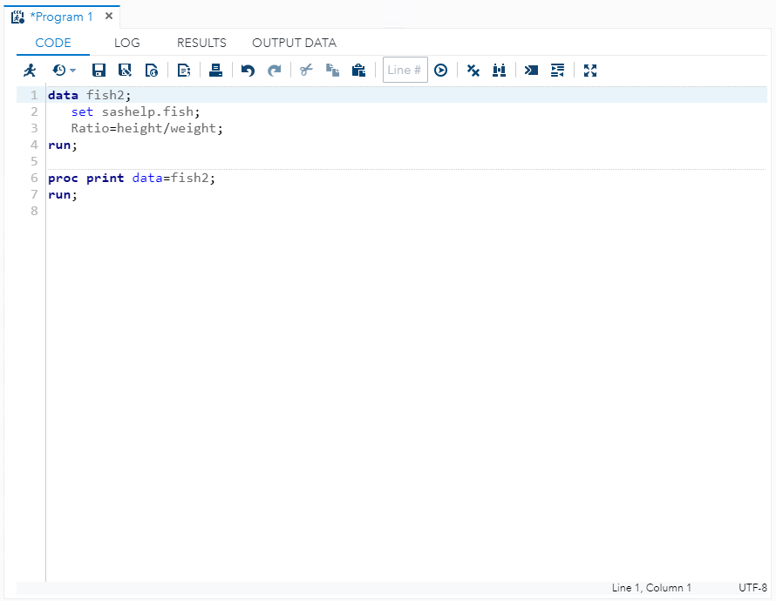
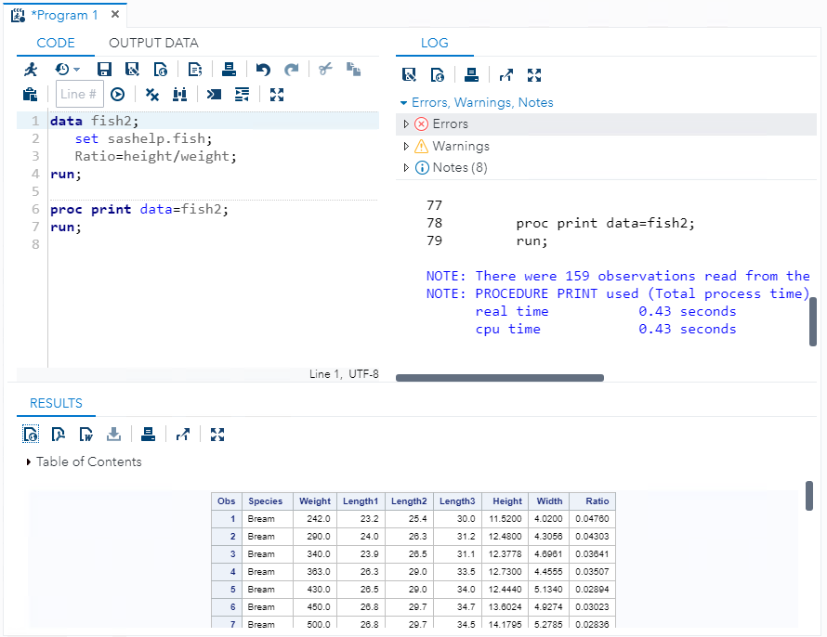
Work Area Layout
Notes:
SAS Studio enables you to drag the CODE, LOG, RESULTS, and OUTPUT DATA tabs to separate sections in the work area to customize this space. Your preferred layout persists until you change it.

Slide 13
Files and Folders Section
Notes:
You can use the Files and Folders section in the navigation pane to do the following:
Open a SAS program
Create a new SAS program
Create folders and folder shortcuts
Download files
Upload files

Slide 14
1.03 Activity
Use the Files and Folders section to navigate to the course files folder SSPG38.
Right-click the SSPG38 folder and select Copy To.
Select Files (Home) and click Copy.
Expand your copy of SSPG38 open the sp01a03.sas program.
Click (Run). The output should contain a listing report and a map chart.
Use the LOG tab to identify and locate any warnings or errors.
Fix the code and rerun the program to resolve any warning or errors.

Slide 15
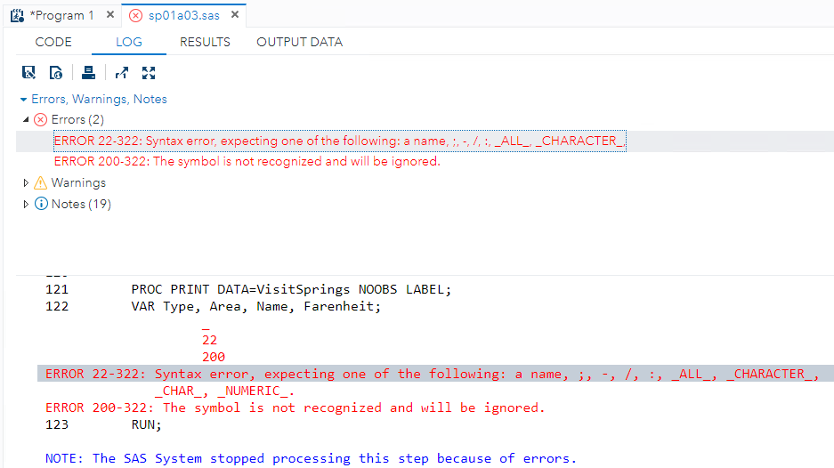
1.03 Activity – Correct Answer
Commas are used to separate column names in the VAR statement.

Slide 16
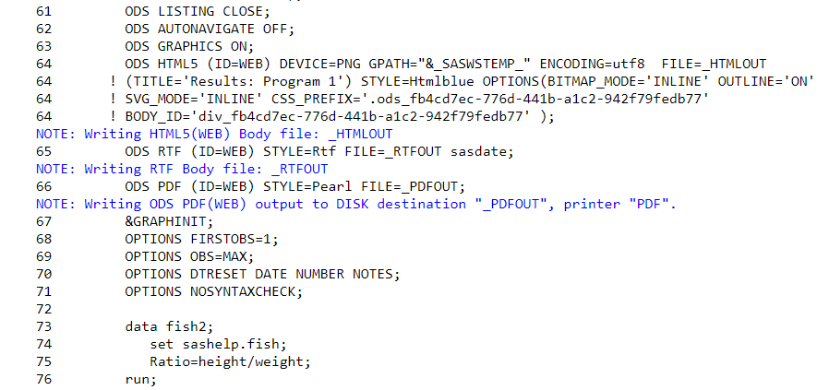
Wrapper Code
Notes:
SAS Studio automatically adds wrapper code around submitted code to format the results. The wrapper code includes statements to generate results in different formats and close any open quotation marks, comments, or steps. By default, the wrapper code is hidden in the SAS log.
Carefully examine the Log window to determine whether the wrapper code causes issues in your program.

Slide 17
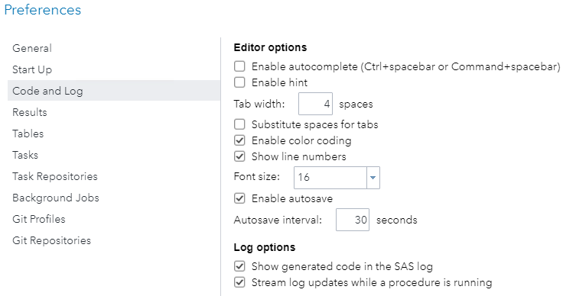
1.04 Activity
Click (More application options) ⇨ Preferences. Then select Code and Log.
Select the Show generated code in the SAS log check box.
Click Save.
Click the Program 1 tab.
Run the program and examine the LOG tab.
Confirm that the wrapper code is displayed.

Slide 18
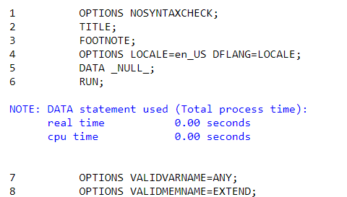
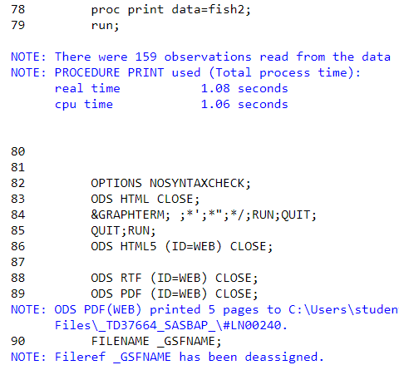
1.04 Activity – Correct Answer
The wrapper code is automatically generated.

Slide 19
1.05 Multiple Choice Poll
Examine the generated wrapper code. What is the value the of the VALIDVARNAME= option?
V7
ANY
_ALL_
UPCASE
Notes:
Correct Answer: b (ANY)

Slide 20
1.05 Multiple Choice Poll – Correct Answer
Examine the generated wrapper code. What is the value of the value of VALIDVARNAME= option?
V7
ANY
_ALL_
UPCASE
Notes:
Correct Answer: b (ANY)

Slide 21
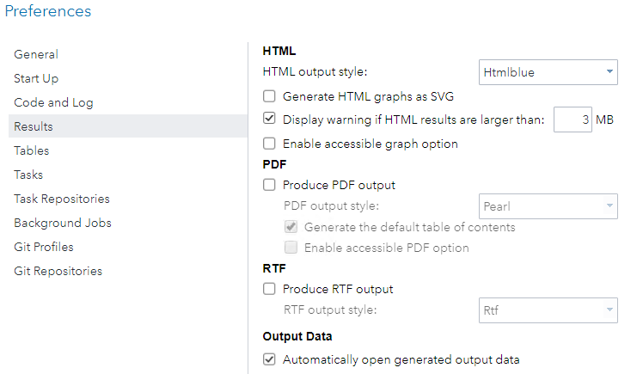
Wrapper Code
Clear the PDF and RTF check boxes to remove extra ODS statements in the wrapper code.
Notes:
You can use Preferences to eliminate or modify some wrapper code.

Slide 22
Questions?

Slide 23
Lesson 1: Programming in SAS® Studio
1.1 Submitting SAS Code in SAS Studio
1.2 Using Features of the SAS Studio Editor
1.3 Converting Programs to SAS Studio

Slide 24


Features of the SAS Studio Editor
Format code
Integrated syntax help
Autocomplete
Automatic library reassignment
Background submit
Program summary
Export results
Notes:
The SAS Studio editor includes several unique features to facilitate the development of your SAS programs.
The Format Code automatically adds line breaks and indents each line correctly according to its nesting level.
The integrated syntax help causes the code editor to display brief SAS syntax documentation as you write and edit your program.
Autocomplete, also known as code completion, suggests valid options or keywords you can use before you finish typing it.
Background submit allows you to run a saved SAS program as a background job, which means that the program can run while you continue to use SAS Studio.
You can create a program summary, which includes information about program execution, the complete SAS source code, the complete SAS log, and the results.
By default, SAS Studio generates HTML5, PDF, and RTF output, providing a quick way to export results in those formats.
Finally, using an automatic library assignment, you can create a library that is automatically assigned when you start SAS Studio and, therefore, ready for you to use.

Slide 25
Customizing the Editor
Use the More application options menu to modify the editor preferences.
Notes:
You can customize the editor by clicking the More application options menu and then selecting Preferences ⇨ Code and Log.

Slide 26
Using Features of the SAS Studio Editor
This demonstration illustrates using features of the SAS Studio editor, including automatic formatting, integrated syntax Help, autocomplete, results export, automatic library reassignment, and batch mode.

Slide 27
Questions?

Slide 28
Practice
This practice reinforces the concepts discussed previously.

Slide 29
Lesson 1: Programming in SAS® Studio
1.1 Submitting SAS Code in SAS Studio
1.2 Using Features of the SAS Studio Editor
1.3 Converting Programs to SAS Studio

Slide 30
Transitioning Programs to SAS Studio
What statements do I need to update? INFILE, LIBNAME, ODS, …?
Notes:
You might need to update code when moving programs from other SAS environments to SAS Studio. The updates should reflect the changes in the location and the configuration of the new SAS server.
Any programming statements that involve host-specific references to external locations need to be updated for the new environment. These references might include, but are not limited to, the following items:
INFILE or FILE statements
FILENAME statements
%INCLUDE statements
paths for libraries, catalogs, or formats
stored macros or macro autocall libraries
Output Delivery System statements

Slide 31

Local Files with Remote SAS
Notes:
Regardless of the method of submission, all SAS code goes to a sas.exe process for execution. If you are migrating from a configuration with SAS on a PC, consider that the code might now be executed on a remote SAS server. All file references must point to locations on the server. If you have local data or programs that you want to access, use the Upload button to select files and upload them to the SAS server.

Slide 32
1.06 Activity
Select Files and Folders in the navigation pane and expand Folder Shortcuts ⇨ My Documents. Select the My SAS Files folder.
Click (Upload).
In the Upload Files window, click Choose Files.
Navigate to the course files folder and select Sales.xlsx. Click Open.
Click Upload.
Verify that the Sales Excel file was added to My SAS Files.

Slide 33
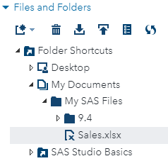
1.06 Activity – Correct Answer
Verify that the Sales Excel file was added to the My SAS Files folder.
Notes:
In the training environment, it is likely that SAS is installed locally. This quiz copies a local file to the My SAS Files folder, which is also on the local machine. The process of uploading a data set to a remote SAS server is exactly the same as the steps outlined in the quiz.
Note: When you upload local SAS data sets to a remote SAS server, it is not required that SAS be installed on the local machine.

Slide 34
Server Configuration
PROC OPTIONS
Preferences
Program Code
Server Options
Notes:
SAS Studio might start SAS with options that differ from your previous SAS environment. These are some methods of exploring default settings.
You can use PROC OPTIONS to examine option values.
You can explore the default settings in Preferences and modify settings if permitted.
Additionally, you should update individual programs with required statements.
As appropriate, work with your SAS administrator to determine if SAS server options should be modified for all users.

Slide 35
Autoexec File
Autoexec file
Notes:
If you need to change your options for the SAS server, first consult with your SAS Administrator. Some options can be overridden through a personal autoexec file. A SAS autoexec file contains SAS statements that are executed automatically whenever SAS Studio is opened. However, some options are able to be set only at system startup. Your SAS Administrator will be able to tell you which options you can change or override and which are set for the server.

Slide 36
Activity Setup
Open sp01a07.sas.
Run the program.
sp01a07.sas
Examine the results.
MPG Range | Label
Low - 20 | Low
20 <- 30 | Medium
30 <- High | High
Notice that the mpg_groups user-defined format is not applied.
mpg_groups
Notes:
The mpg_groups is a user-defined format that establishes ranges for mpg values. Open the sp01a06.sas program. A FORMAT statement is included to apply the mpg_groups user-defined format to MPG_Highway column.
Run the program and examine the results. Notice that the format is not applied. A format catalog is included in the course data, but the FMTSEARCH system option must be set so that SAS can find and use the mpg_groups format.

Slide 37

1.07 Activity
Click (More application options) ⇨ Edit Autoexec File.
Add the following statements to establish the library and to specify the location of the format library:
Click Run and verify that the program runs successfully.
Click Save.
Return to the sp01a07.sas program and run it again. Verify that the mylib library is defined and that the report is created successfully with the formatted values.
libname mylib "s:\workshop";
options fmtsearch=(mylib work);

Slide 38
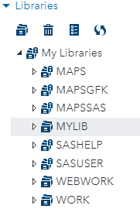
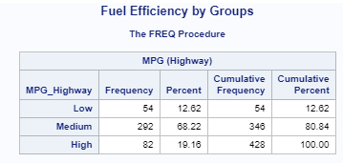
1.07 Activity – Correct Answer
Verify that MYLIB is assigned at start-up and that the values of MPG_Highway are formatted.

Slide 39
1.08 Question
Using the Library section of the navigation pane, do you see the formats catalog in the mylib library ?
 Yes
 No
Notes:
Answer: No

Slide 40
1.08 Question – Correct Answer
Using the Library section of the navigation pane, do you see the formats catalog in the mylib library ?
 Yes
 No
Notes:
Answer: No

Slide 41
Practice
This practice reinforces the concepts discussed previously.

Slide 42
Programming Statements to Avoid
Require administrator permissions.
Generate SAS windowing environment windows or prompts.
Terminate the connection between SAS Studio and the SAS server.
Read and write Microsoft files with Dynamic Data Exchange (DDE).
X, SYSTASK
DEBUG, AF applications
ABORT, ENDSAS
DDE engine
Notes:
You should try to avoid using some types of code in SAS Studio:
Some commands might not work unless permission is granted by the administrator, such as code that submits operating system commands such as X or SYSTASK.
Code that normally causes a window or prompt to appear in the SAS windowing environment does not work in SAS Studio. Examples include DEBUG and AF applications.
Code that terminates the SAS process with ABORT or ENDSAS terminates the connection between SAS Studio and the SAS server. While SAS Studio automatically reconnects to the SAS server, temporary files are deleted.
Code that uses Dynamic Data Exchange (DDE) to read and write Microsoft files should also be avoided.

Slide 43
Interactive Mode
proc sql;
select avg(mpg_city) as Avg_MPG
from sashelp.cars
where origin="USA";
You can run selected lines of code and use the results to determine next steps.
select type, count(type)as Number,
avg(mpg_city)as Avg_MPG,
from sashelp.cars
where mpg_city >= ???????
group by type;
quit;
Notes:
SAS Studio has a special mode for programmers who use interactive procedures. These types of procedures enable you to submit multiple statements without exiting the procedure. Interactive procedures include SQL, DATASETS, and statistical procedures such as IML, REG, and GLM.
Using interactive mode, you can run selected lines of code from your SAS program. Then, use the results from the code submitted to determine your next actions.
Read through the Working in Interactive Mode section of the SAS Studio User's Guide to understand the differences in how interactive mode works versus the default mode for SAS Studio.
Note: When you run a program in interactive mode, SAS Studio has the following features:
SAS Studio does not add any automatically generated code, such as ODS and %LET statements, to your program.
Results are generated only in HTML.
The log and results are appended to the existing log and results.
Previously submitted code remains active until you terminate it.

Slide 44
Questions?

